Slide 1
Week 2|Forms
Formularios
Review – Repaso
Personal Subject Pronouns – Pronombres personales de sujeto
Be-Verbs – El verbo to be
Singular and Plural Nouns – Sustantivos singulares y plurales
Demonstrative Pronouns – Pronombres demostrativos
Prepositions of Place – Preposiciones de lugar
There Is/Are Construction – Construcción de “there is/are”
Wh-Questions – Preguntas de la Wh
Practice with Forms – Práctica con los formularios

Slide 2
Personal (Subject) Pronouns
Los pronombres personales (de sujeto)
yo | nosotros nosotras |  | I | we
tú vos | (vosotr@s) |  | you
él ella Ud. | ellos ellas Uds. |  | he she it | they
[ai]
[wi]
you all [juˈal]
[ju]
you guys [juˈgaɪz]
y’all [jal]
[hi]
[ʃi]
[ðei]
[ɪt]

Slide 3
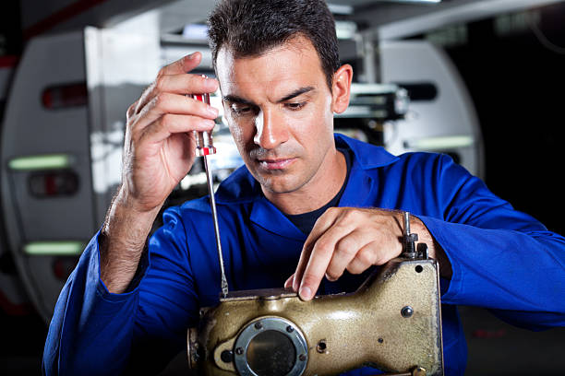
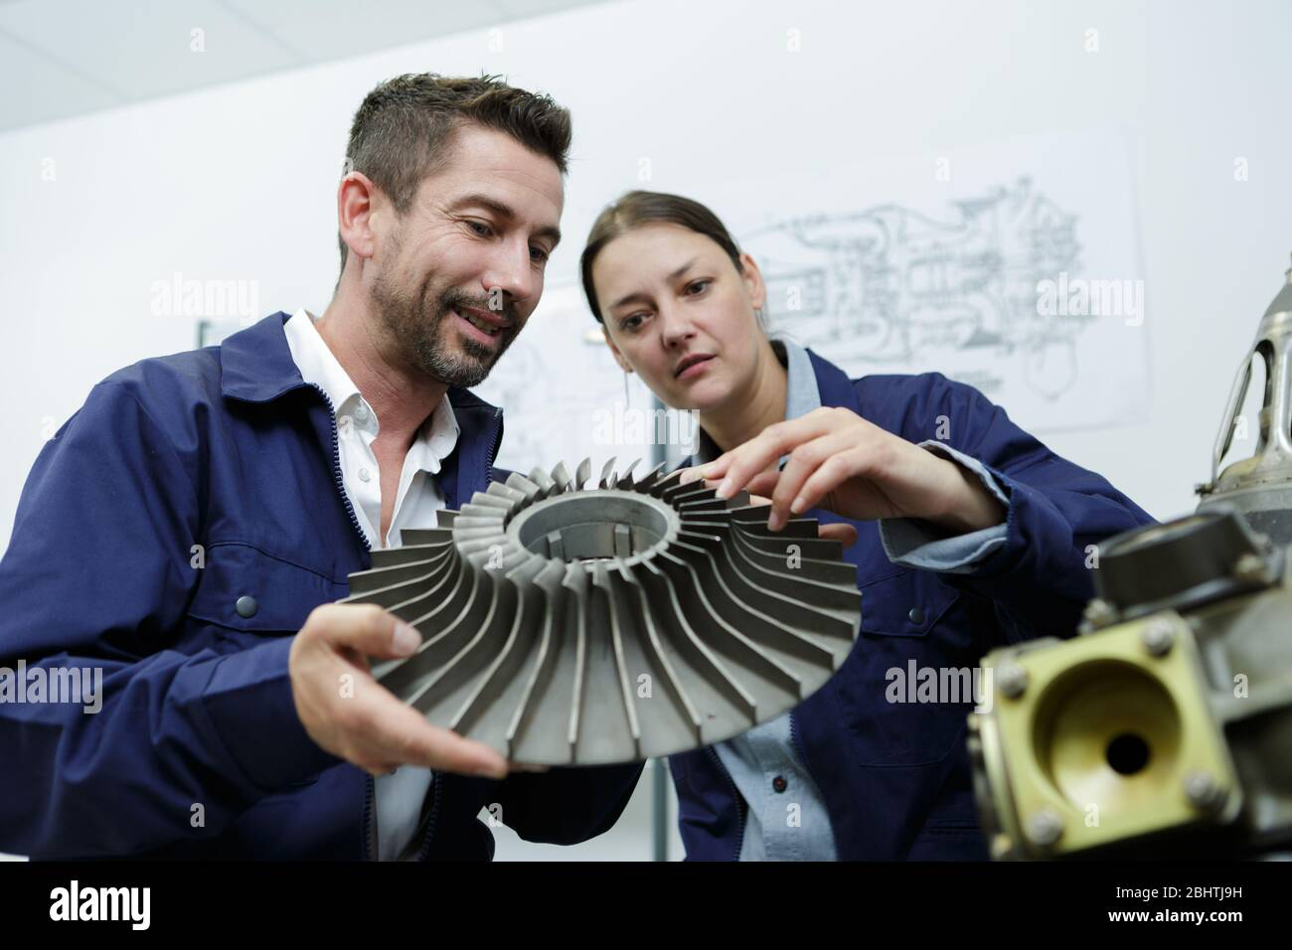
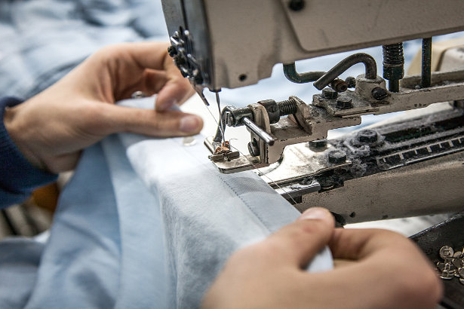
Personal (Subject) Pronouns
Los pronombres personales (de sujeto)
I | we
you
he she it | they
1. The man fixes the machine.
2. The woman checks the work.
1. The stitches hold the fabric together.

Slide 4
Personal (Subject) Pronouns
Los pronombres personales (de sujeto)
1. He fixes the machine.
2. The woman checks the work.
1. The stitches hold the fabric together.

Slide 5
Personal (Subject) Pronouns
Los pronombres personales (de sujeto)
1. He fixes it.
2. The woman checks the work.
1. The stitches hold the fabric together.

Slide 6
Personal (Subject) Pronouns
Los pronombres personales (de sujeto)
1. He fixes it.
2. The woman checks the work.
1. The stitches hold the fabric together.
Subject Pronoun
The person/thing who performs the action

Slide 7
Personal (Subject) Pronouns
Los pronombres personales (de sujeto)
1. He fixes it.
2. The woman checks the work.
1. The stitches hold the fabric together.
Subject Pronoun
The person/thing who performs the action
Object Pronoun
The person/thing the action is performed upon

Slide 8
Personal (Subject) Pronouns
Los pronombres personales (de sujeto)
1. He fixes it.
2. She checks the work.
3. The stitches hold the fabric together.
Subject Pronoun
The person/thing who performs the action
Object Pronoun
The person/thing the action is performed upon

Slide 9
Personal (Subject) Pronouns
Los pronombres personales (de sujeto)
1. He fixes it.
2. She checks the work.
3. They hold the fabric together.
Subject Pronoun
The person/thing who performs the action
Object Pronoun
The person/thing the action is performed upon

Slide 10
Personal (Subject) Pronouns
Los pronombres personales (de sujeto)
1. He fixes it.
2. She checks the work.
3. They hold it together.
Subject Pronoun
The person/thing who performs the action
Object Pronoun
The person/thing the action is performed upon

Slide 11
Subject, Object, Verb
Sujeto, objeto, verbo
Both Spanish and English are SVO languages
The Subject is usually first
  The Subject is the person or thing that performs the action or is the focus of the sentence
The Verb is usually second
  The Verb is the action that is performed or it is a linking-verb, like to be
The Object is usually last, but may not always exist
  The Object receives the action
The girl hit the baseball.

Slide 12
Subject, Object, Verb
Sujeto, objeto, verbo
Both Spanish and English are SVO languages
The Subject is usually first
  The Subject is the person or thing that performs the action or is the focus of the sentence
The Verb is usually second
  The Verb is the action that is performed or it is a linking-verb, like to be
The Object is usually last, but may not always exist
  The Object receives the action
The girl hit the baseball.

Slide 13
Subject, Object, Verb
Sujeto, objeto, verbo
Both Spanish and English are SVO languages
The Subject is usually first
  The Subject is the person or thing that performs the action or is the focus of the sentence
The Verb is usually second
  The Verb is the action that is performed or it is a linking-verb, like to be
The Object is usually last, but may not always exist
  The Object receives the action
The girl hit the baseball.

Slide 14
Subject, Object, Verb
Sujeto, objeto, verbo
Both Spanish and English are SVO languages
The Subject is usually first
  The Subject is the person or thing that performs the action or is the focus of the sentence
The Verb is usually second
  The Verb is the action that is performed or it is a linking-verb, like to be
The Object is usually last, but may not always exist
  The Object receives the action
The girl hit the baseball.

Slide 15
Subject, Object, Verb
Sujeto, objeto, verbo
Both Spanish and English are SVO languages
The Subject is usually first
  The Subject is the person or thing that performs the action or is the focus of the sentence
The Verb is usually second
  The Verb is the action that is performed or it is a linking-verb, like to be
The Object is usually last, but may not always exist
  The Object receives the action
The girl hit the baseball.
The girl is very smart.

Slide 16
Subject, Object, Verb
Sujeto, objeto, verbo
Both Spanish and English are SVO languages
The Subject is usually first
  The Subject is the person or thing that performs the action or is the focus of the sentence
The Verb is usually second
  The Verb is the action that is performed or it is a linking-verb, like to be
The Object is usually last, but may not always exist
  The Object receives the action
The girl hit the baseball.
The girl is very smart.

Slide 17
Subject, Object, Verb
Sujeto, objeto, verbo
Both Spanish and English are SVO languages
The Subject is usually first
  The Subject is the person or thing that performs the action or is the focus of the sentence
The Verb is usually second
  The Verb is the action that is performed or it is a linking-verb, like to be
The Object is usually last, but may not always exist
  The Object receives the action
The girl hit the baseball.
The girl is very smart.

Slide 18
Subject, Object, Verb
Sujeto, objeto, verbo
Both Spanish and English are SVO languages
The Subject is usually first
  The Subject is the person or thing that performs the action or is the focus of the sentence
The Verb is usually second
  The Verb is the action that is performed or it is a linking-verb, like to be
The Object is usually last, but may not always exist
  The Object receives the action
The girl hit the baseball.
The girl is very smart.

Slide 19
To Be – Ser and Estar Together
ser
estar
yo soy
nosotros somos
yo estoy
nosotros estamos
tú eres | vos sos
tú/vos estás
él/ella/Ud. es
ell@s/Uds. son
él/ella/Ud. está
ell@s/Uds. están
to be
I am
we are
[æm]
you are
[ɑːɹ]
he/she/it is
they are
[ɪz]

Slide 20
To Be – Ser and Estar Together
ser
estar
yo soy
nosotros somos
yo estoy
nosotros estamos
tú eres | vos sos
tú/vos estás
él/ella/Ud. es
ell@s/Uds. son
él/ella/Ud. está
ell@s/Uds. están
to be
I’m
we’re
[aɪm]
[wiɹ] [wɝr]
you’re
[joɹ]
he’s
she’s
it’s
they’re
[hiz]
[ðeiɹ]
[ʃiz]
[ɪts]

Slide 21
To Be – Ser and Estar Together
Old - viejo
Young - joven
Early - temprano
Late - tarde
Tall - alto
Short - corto
Cold – (tener) frío
Warm – (tener) calor
Hungry – (tener) hambre
Sick - enfermo
Fast - rápido
Slow - lento
I am
we are
you are
he/she/it is
they are

Slide 22
Singular and Plural Nouns
Sustantivos singulares y plurales
Most English nouns form the plural by adding -s to the end of the singular form
  needle > needles; filter > filters
Nouns that already end in -s, -ss, -z, -ch, -sh, or -x add -es to form the plural
  watch > watches; box > boxes
There are many irregular nouns that don’t follow either rule
  child > children; deer > deer; hero > heroes; tooth > teeth

Slide 23
Singular and Plural Nouns
Sustantivos singulares y plurales
Tools and Building Supplies
Making Clothes
Alexander – 1, 4, 22 & 9, 16
Cecilia – 3, 12, 25 & 13, 34
Edin – 10, 16, 47 & 12, 31
Fernanca – 6, 35, 48 & 11, 30
Gabriel – 9, 27, 54 & 9, 28
Ismael – 2, 23, 37 & 8, 26
Jhuleidy – 29, 39, 52 & 6, 25
Luis – 8, 17, 55 & 5, 21
Manuel – 5, 28, 41 & 4, 18
Rosa – 11, 21, 57 & 3, 17
Eddi – 26, 32, 38 & 2, 16
Leonardo – 24, 40, 51 & 1, 14

Slide 24
The Demonstrative Pronouns
Los pronombres demostrativos
[ˈes.to]
[ˈe.so]
[aˈke.ʝo]
In Spanish, there are 3 demonstrative pronouns: esto, eso, and aquello
  Este es mi libro.
These are the same as the demonstrative adjectives.
  Este libro es grande.
There are 2 English demonstrative pronouns: this/these and that/those
  This is my book.
These are the same as the demonstrative adjectives.
  This book is big.
[ðɪs]
[ðiz]
[ðæt]
[ðoz]

Slide 25
The Demonstrative Pronouns
Los pronombres demostrativos
These threads are long, but those are short.
This filter cartridge is dirty, but that is clean.

Slide 26
The Demonstrative Pronouns
Los pronombres demostrativos
Old - viejo
New - nuevo
Tall - alto
Long - largo
Short - corto
Cold - (tener) frío
Warm - (tener) calor
Dirty - sucio
Clean - limpio
Fast - rápido
Slow - lento
Red
Blue
Grey
Gray
Orange
Purple
Brown
Yellow
White
Pink
Green
Black

Slide 27
Prepositions
Las preposiciones
Preposiciones son palabras que muestran una relación entre dos o más sustantivos
Preposiciones son “idiomáticas” y no siempre tiene sentido por qué a veces usamos una en vez de otra

Slide 28
Prepositions of Place
Las preposiciones de lugar
I watch TV in the living-room
I live in New York
Look at the picture in the book
She looks at herself in the mirror.
She is in the car.
Look at the girl in the picture
This is the best team in the world
in
en (dentro)

Slide 29
Prepositions of Place
Las preposiciones de lugar
I met her at the entrance.
I met him at the bus stop.
She sat at the table.
I am at a concert.
You are at the party.
We are at the movies.
They are at school.
You guys are at work.
at
en (preciso), mesa, eventos,
lugar típico para una actividad

Slide 30
Prepositions of Place
Las preposiciones de lugar
Look at the picture on the wall.
Neenah is on Lake Winnebago.
The book is on the desk.
He has a smile on his face.
The shop is on the left.
My apartment is on the first floor.
I love traveling on trains /on the bus / on planes.
This is my favorite show on TV/ on the radio.
on
en (encima de), fijado, al lado de (río/calle),
a la (izquierda/derecha), pisos,
metodos para viajar, la televisión/radio

Slide 31
Prepositions of Place
Las preposiciones de lugar
by
next to
beside
near
The girl is by the house.
The man is next to the machine.
I went beside the wall.
They live near the school.
cerca de, al lado de

Slide 32
Prepositions of Place
Las preposiciones de lugar
between
The town is halfway between Milwaukee and Green Bay.
The fabric goes between the presser foot and the base of the sewing machine.
entre

Slide 33
Prepositions of Place
Las preposiciones de lugar
behind
I hung my coat behind the door.
The box I need is behind the rest.
detrás de/atrás de

Slide 34
Prepositions of Place
Las preposiciones de lugar
in front of
She started talking to the man in front of her.
Christopher is in front of you.
enfrente de, frente a, delante de

Slide 35
Prepositions of Place
Las preposiciones de lugar
The cat is under the blanket.
The chair goes under the table.
The box is beneath the projector.
The fish live beneath the water.
under
underneath
beneath
bajo, debajo de, abajo de

Slide 36
Prepositions of Place
Las preposiciones de lugar
The coffee maker is below the coffee cups.
The laundry room is below, in the basement.
The sun shines on us below.
below
bajo, debajo de, abajo de

Slide 37
Prepositions of Place
Las preposiciones de lugar
over
She held the umbrella over both of us.
The cow jumped over the moon.
I walked over the bridge.
He jumped over the gate.
encima de, por encima de, sobre, por

Slide 38
Prepositions of Place
Las preposiciones de lugar
above
The path goes above the lake.
The apartment is above a bakery.
por encima de

Slide 39
Prepositions of Place
Las preposiciones de lugar
There is a shortcut across the field.
There is a door across the room.
We lay the fabric across the pallets.
across
que cruza, cruzando, en cruz

Slide 40
Prepositions of Place
Las preposiciones de lugar
We walked through the building.
We will go through the form.
through
a través de

Slide 41
Prepositions of Place
Las preposiciones de lugar
He goes to the office.
I walk to work.
She sews the bottoms to the bags.
We apply the glue to the filter.
to
a, hacia, sobre

Slide 42
Prepositions of Place
Las preposiciones de lugar
You put your hand into the bag.
We drill screws into the wood.
He ran into the wall.
into
a (un lugar interno), contra (golpe)

Slide 43
Prepositions of Place
Las preposiciones de lugar
She walks toward the door.
You guys face towards the whiteboard.
toward(s)
hacia

Slide 44
Prepositions of Place
Las preposiciones de lugar
onto
We went onto the roof.
They stepped onto the workfloor.
She climbed onto the table.
en, sobre

Slide 45
Prepositions of Place
Las preposiciones de lugar
I am from West Salem, Wisconsin.
She is from Ecuador.
Her friend is from El Salvador.
We walked from the theater to the restaurant.
These filters are from FABCO.
This fabric comes from another company.
from
de, desde

Slide 46
There Is/Are Construction
La construcción “there is/are”
There is/are is how we say that something exists
There = allá, but it is a “dummy” word
Unlike hay, there is/are changes based on the number of objects
Ex:
  There is a projector in the room.
  There are several tables in the room.
  There is a pair of shoes on my feet.

Slide 47
Wh-Questions
Preguntas de la Wh
Spanish has many question words that start with a K sound
  Cuándo, cómo, cuán, cuánto, quién, qué
English has many question words that start with a W sound
They are usually spelled with a wh-
In questions, we almost always invert the subject and verb
Who - quién
What - qué
What for - para qué
When - cuándo
Where - dónde
Why - por qué
How - cómo
How many/much - cuánto(s)

Slide 48
Wh-Questions
Preguntas de la Wh
Who sits next to Rosa? Quién se sienta al lado de Rosa?
What are we sitting on? En qué nos sentamos?
What are the needles for? Para qué son las agujas?
When will he come back? Cuándo va a regresar?
Where is he coming from? De dónde viene?
Why are the dogs barking? Por qué ladran los perros?
How do I sew the filter? Cómo coso el filtro?
How many people are here? Cuántas personas hay acá?

Slide 49
Work Orders

Slide 50
El método sencillo para aprender idiomas
Es muy sencillo aprender un idioma (aunque no es fácil)
Es más fácil aprender un idioma como adulto que como bebé o niño
Es obligatorio equivocarse para aprender un idioma

Slide 51
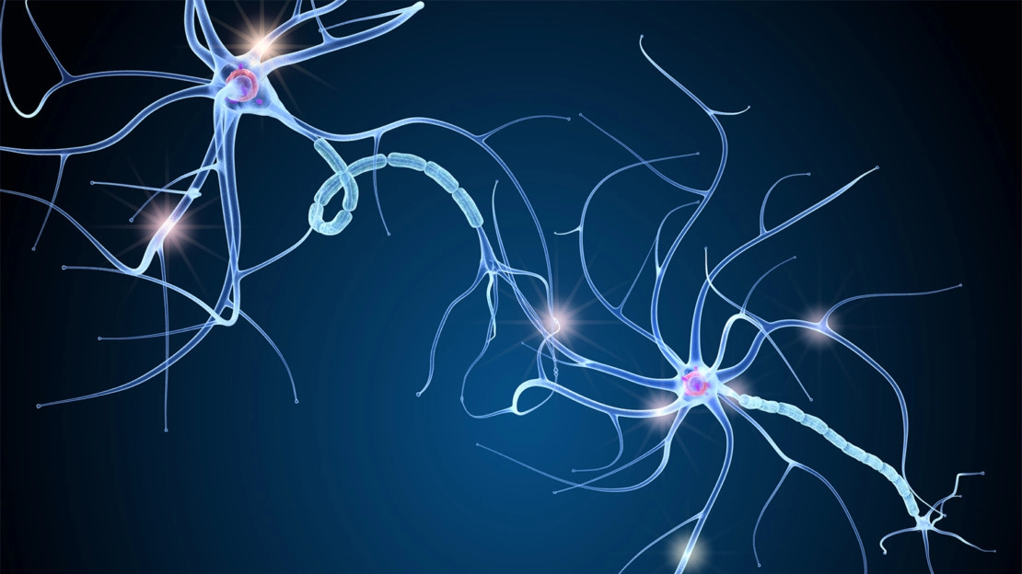
Notes:
Las neuronas
Las synapsis

Slide 52


Slide 53
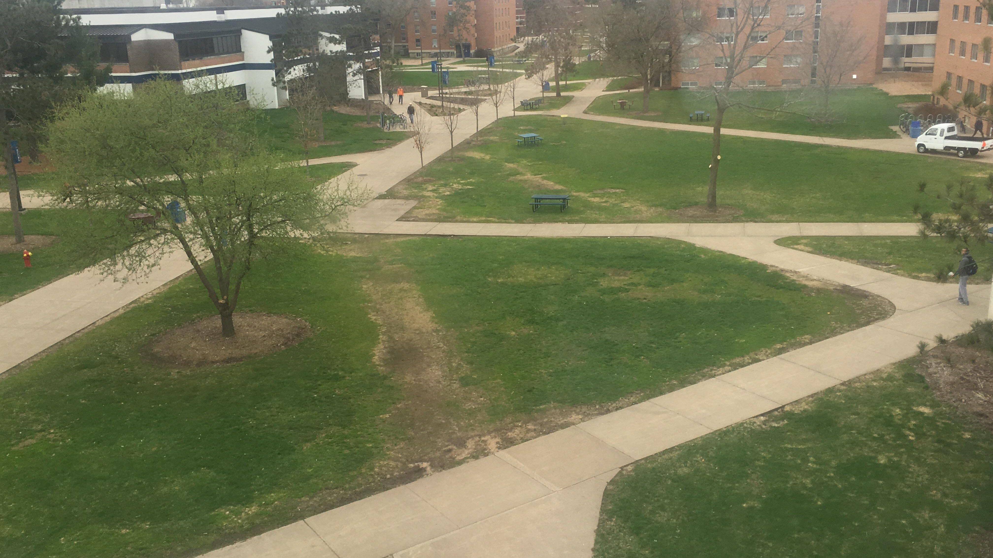
Notes:
Camino de deseo

Slide 54
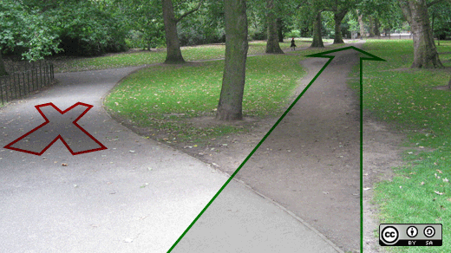
Notes:
pavimentar

